Slide 1
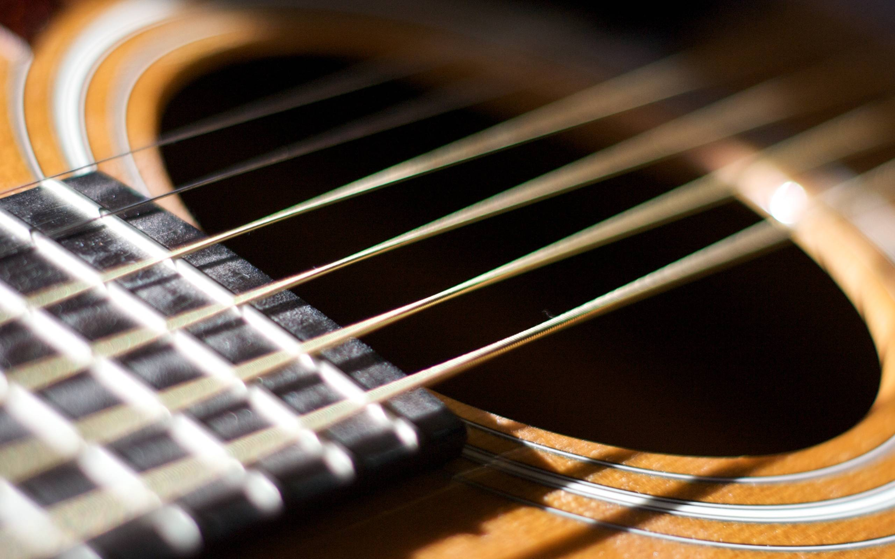

StringsSense (Guitar Tuner App)
Team Rust: Carlton Brown
Jackson Dukes
Tony Imbesi
Abri Witchett
Image via : https://wallpapercave.com/acoustic-guitar-wallpaper

Slide 2
Tuning Basics
E | F | F# (Gb) | G | G# (Ab) | A | A# (Bb) | B | C | C# (Db) | D | D# (Eb)
1 | 2 | 3 | 4 | 5 | 6 | 7 | 8 | 9 | 10 | 11 | 12
1 semitone
A semitone, also called a half step or a half tone, is the smallest musical interval commonly used in Western tonal music. It is defined as the interval between two adjacent notes in a 12-tone scale.
The semitone is our unit of measure between notes. One 100th of a semitone is called a “cent”.
When played individually, the average human ear can’t detect a difference of less than 5 cents.

Slide 3
frequency Ranges (HZ)
E | F | F# (Gb) | G | G# (Ab) | A | A# (Bb) | B | C | C# (Db) | D | D# (Eb)
1 | 2 | 3 | 4 | 5 | 6 | 7 | 8 | 9 | 10 | 11 | 12
1 semitone
The acceptable (in tune) range is within 3 cents above or below the nearest perfect frequency. This is calculated by one of the following formulas, depending on whether the input frequency is flat or sharp relative to the nearest perfect frequency:
If flat:
nearest perfect frequency - (0.03 * |nearest perfect frequency – next nearest perfect frequency|)
If sharp:
nearest perfect frequency + (0.03 * |nearest perfect frequency – next nearest perfect frequency|)

Slide 4
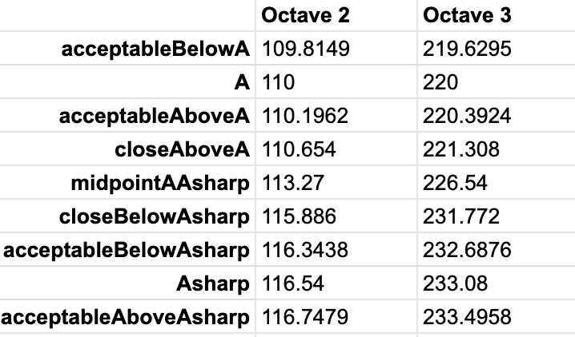
frequency Ranges (HZ) Cont.
The slightly out of tune range is within 10 cents above or below the nearest perfect frequency. This is calculated by one of the following formulas, depending on whether the input frequency is flat or sharp relative to the nearest perfect frequency:
If flat:
nearest perfect frequency - (0.1 * |nearest perfect frequency – next nearest perfect frequency|)
If sharp:
nearest perfect frequency + (0.1 * |nearest perfect frequency – next nearest perfect frequency|)
Any value greater than 10 cents above or below the nearest perfect frequency will be in the out of tune range.

Slide 5


Database Demo

Slide 6


functional requirements
The app should allow users to tune their guitar to EADGBE tuning
The app should show users the note that is closest to their plucked string
The app should show users how close they are to the correct tuning via a color-coded accuracy rating.
The app should have a mute button to turn off microphone
The app should provide audio feedback during tuning

Slide 7
non-Functional requirements
The app shall be able to read values from a frequency-to-pitch database to calculate accuracy.
The app shall provide accurate visual feedback of the note within 4 seconds of plucking a string.
The app shall use the built-in device microphone to read audio input and obtain the frequency value.
The app shall run as either an Android app or a webpage.
The app shall load within 4 seconds upon opening

Slide 11
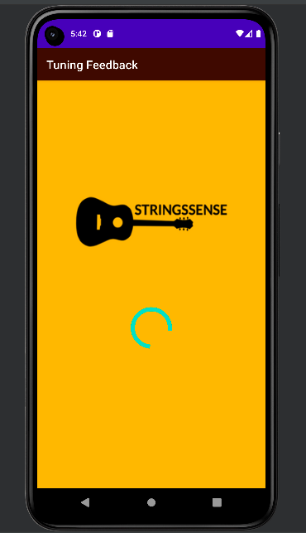

System Demo

Slide 12
Accomplishments + team experience
Goal: to build a guitar tuning app that allows users to easily tune their instrument to Standard Tuning (EADGBE) with an acceptable range of accuracy.
We successfully developed a mock-up android application .
Implemented clearer visual and audio feedback for accessibility
We satisfied our requirements within mockup excluding microphone usage.
We built a working database containing musical notes and ranges of frequencies: acceptable, slightly out of tune, and out of tune.
We were able to gain a better understanding of the app development process

